Slide 1
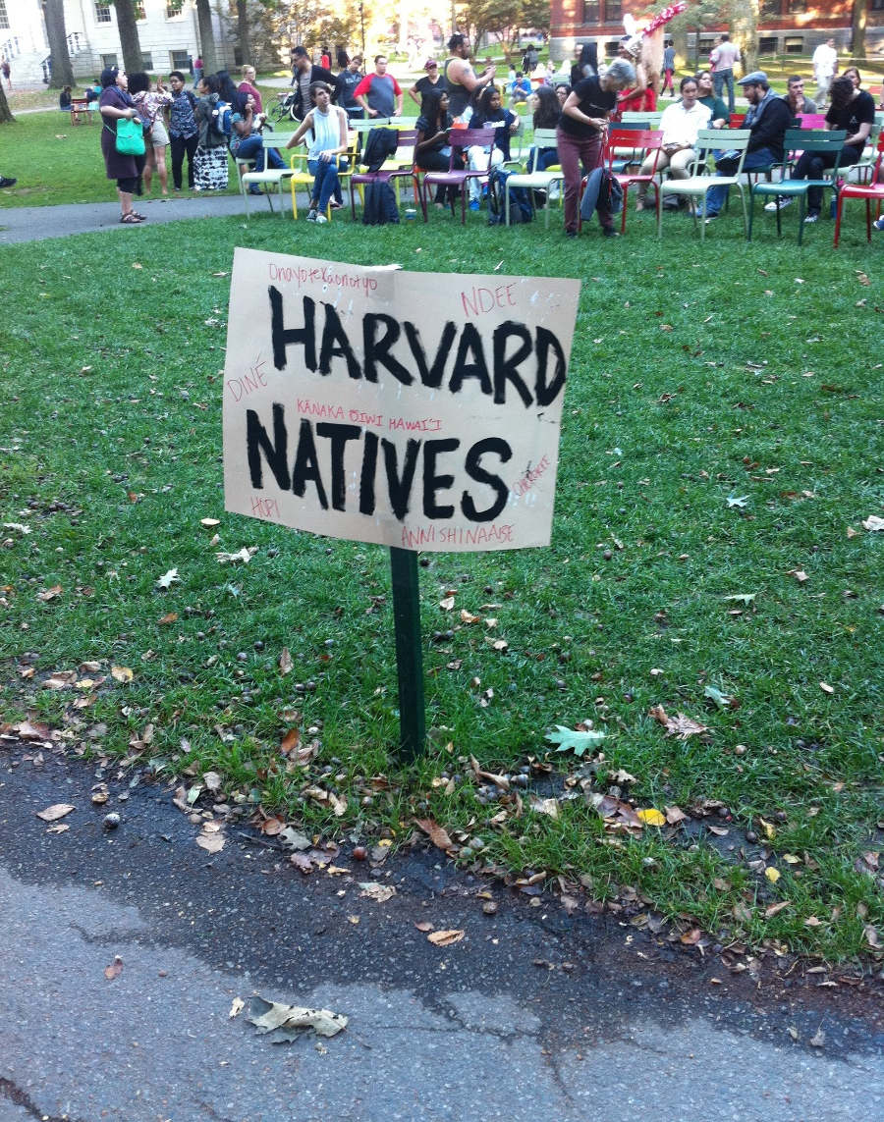
Elite institutions and their new audiences. Student recruitment in a context of widening participation.
Annabelle Allouch
Associate Professor of Sociology
Université de Picardie Jules Verne (CURAPP-ESS/CNRS)

Slide 2
Widening participation schemes (Allouch, 2017)
Widening participation schemes (WP) were developed in the selective tracks/HEI of several European countries from the 2000s onwards.
In France and England, these schemes aim at widening the social composition of the student population, esp. in very elitist institutions (Between 70% and 95% of the student population from Upper MC).
Schemes based on social class rather than ethnic minorities (American model of Aff. Action).
These schemes are based on two models :
-on the one hand, they offer a change in selection criteria so as to adjust to student population from Lower SES (In Bristol Uni, BBC at A-levels for a seat in Law, rather than AAB).
-on the other hand, they target good pupils from lower SES and offer them intensive forms of mentoring. Selection criteria remain the same. In France, this model was labelled by the State in 2008.

Slide 3
Widening participation schemes in France and England : common points
Based critics of meritocracy and traditional forms of selection as socially biased (Use of Bourdieu sociology of reproduction by actors).
⇒Advocate Psychological and individualised treatment of social inequalities (Castel, 1981; Sennett, 1992; Beck, 1992).
⇒General belief in the value of Human Ressources Management (HR) as an effective way to select applicants who will be a future pool of graduates for firms.
Under media scrutiny.
Schemes also reflect a fight for autonomy over admissions between universities and the State.
⇒French HEIs try to be more independent from the State: Access is seen as a tool to reform admissions.
⇒In England, access as a constraint to standardize and rationalize admissions (and also reduce the number of universities) (Henkel, 2007; Soares, 1998) and counter traditional academic control over admissions. (Deem, 2007)

Slide 4
How do Widening participation schemes affect institutions?
According to sociologists, selective admissions sort out individuals on academic criteria according to their social dispositions. (Bourdieu, Passeron, 1964; Bourdieu, 1989; Karabel, 1984, 2005).
This « sorting out » activity allows a coordination between specific institutions and social groups, according to their position within social space.
In this perspective, transition to Higher education can be understood as partly based on an activity of coordination.
Pb : How does WP affect this activity of coordination by admissions services in these institutions?

Slide 5
Theorical framework : WP as a « channelling » of students
Coordination is a well-known process in Economic sociology.
The notion of channeling (captation in French) describes the social activities that help supply meet demand, esp. on a service market (Cochoy, 1999, 2004; Trompette, 2005).
This process can be based on a material organization (ex: the pathway channelling customers at IKEA) but also on discursive and symbolic channeling based on marketing devices or ‘emotion management’ (Hoschild, 1983).
To what extent could « channeling » be useful to understand the consequences of WP on admissions change in elite Higher education?

Slide 6
Methodology : The case of Oxford University
Good example of a WP imposed by the public authorities from 2000’s under a Labour government (HEFCE, OFFA) in a context of fee increase.
WP introduces a new type of audience whose social characteristics differ from the institution’s original missions of educating the clergy and the aristocratic elites from the 16th century (Soares, 1999).
A one-year ethnography at Oxford University and its colleges (500 h participant observation)
50 interviews with staff and academics in charge of admissions + students and teachers involved in widening participation schemes.

Slide 7
I. Creating a bureaucracy of coordination
The first consequence of WP on admissions is to create a new bureaucracy dedicated to the question of coordination.
This new bureaucracy has two characteristics:
-It is embodied by new specialized staff with no academic legitimacy : the Access of Widening participation officers.
-Their work creates a new space in the organisation of admissions, dedicated to the specific recruitment of working-class pupils with good academic results (ie : « potential »).
In this new recruitment space, staff act as intermediaries and prescribers of new judgment patterns in their university choice (taste over proximity, etc.) for pupils from deprived backgrounds.

Slide 8
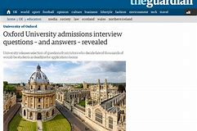
II. Channeling through symbols : management and social neutralization of an exceptional environment
Studies on channelling focus on the material and symbolic environment of economic markets. This interest also highlights the nature of outreach schemes.
-It is based on a socialization to the distinctive traits of Oxford University’s paedagogic and material offer (subjects, libraries, student societies, etc.)
-It is based on the social neutralizing of spaces and practices associated with British elites (chapels, gothic architecture, ref to monarchy, etc).
-This is done thanks to references taken from popular culture (Harry Potter, etc.) rather than popular culture.

Slide 9
III. The limits of channeling
Channeling main limit lies the lack of moral and material constraint over the relationships between the institution and its new users.
Besides, Elite reputation does not work as a strong incentive for secondary teachers, who could choose to leave the scheme at any time.
Unlike Trompette’s model, they don’t help create a spatial and symbolic continuum on the « channeling » process.
Staff are encouraged to stage their own social and academic trajectories to build trust relations. This often relates to a standardized presentation of self as a former student from deprived background experiencing social mobility.

Slide 10
Conclusion
WP illustrates the ability of elite institutions such as Oxford to integrate critics (Boltanski, Chiappello, 1999) and adapt quickly to new audiences.
Elite institutions are then able to manipulate the signal of their excellence but also to change its nature according to different audiences.
The ethnography of WP at Oxford also underlined the inversion of the relationship between students and elite institutions.
In this relationship, the academic institution is not an « all-mighty » institution anymore. Instead, its formal organization depends on the willingness of audiences coming to « her ». That’s what is made visible by the resort of ‘channeling’.

Slide 11
Outline
I. Creating a bureaucracy of coordination.
II. The symbolic channeling : management and neutralisation of an exceptional environment.
III. The limits of channeling in WP : Oxford reputation and the lack of intermediaries.

